Slide 1
Unit-3
Course Name:- Software Engineering
Course Code:- CS3CO40
Course Teacher:- Sachin Yele

Slide 2
Contents
Design

Slide 3


What is Achieved during design phase?
Transformation of SRS document to Design document:
– A form easily implementable in some programming language.
SRS
Design
Document
Documents
Design
Activities

Slide 4
Items Designed During Design Phase
Module structure,
Control relationship among the modules
call relationship or invocation relationship
Interface among different modules,
data items exchanged among different modules,
Data structures of individual modules,
algorithms for individual modules.

Slide 5
Design Principles
S/W design is both a process and a model.
Design process - sequence of steps that enable the designer to describe all aspects of the software to be built.
Design model - created for software provides a variety of different views of the computer software

Slide 6
Design Principles
The design process should not suffer from ‘tunnel vision.’ - Designer should consider alternative approaches.
The design should be traceable to the analysis model - a single element of the design model often traces to multiple requirements, it is necessary to have a means for tracking how requirements have been satisfied by the design model.
The design should not reinvent the wheel- use already exists design pattern because time is short and resource are limited.
The design should “minimize the intellectual distance” between the software and the problem as it exists in the real world. – design should be self-explanatory

Slide 7
Design Principles
The design should exhibit uniformity and integration – before design work begins rules of styles and format should be defined for a design team.
The design should be structured to accommodate change
The design should be structured to degrade gently, even when unusual data, events, or operating conditions are encountered.
Design is not coding, coding is not design.
The design should be assessed for quality as it is being created, not after the fact
The design should be reviewed to minimize conceptual (semantic) errors.

Slide 8
Module
A module consists of:
several functions
associated data structures.
D1 ..
Data
D2 ..
D3 ..
^{F1 ..} Functions
F2 ..
F3 ..
F4 ..
F5 ..

Slide 9
Module Structure

Slide 10
Iterative Nature of Design
Good software designs:
Seldom arrived through a single step procedure:
But through a series of steps and iterations.

Slide 11
Stages in Design
Design activities are usually classified into two stages:
Preliminary (or high-level) design
Detailed design.
Meaning and scope of the two stages:
vary considerably from one methodology to another.

Slide 12
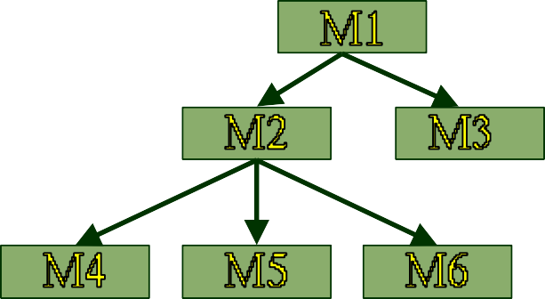
High-level design
d1
d2
Identify:
modules
control relationships among modules
interfaces among modules.
d3
d1
d4

Slide 13
High-level design
The outcome of high-level design:
–program structure, also called software architecture.

Slide 14

High-level Design
Several notations are available to represent high-level design:
– Usually a tree-like diagram called structure chart is used.
– Other notations:
d1
d2
Jackson diagram or Warnier-Orr diagram can also be used.
d3
d4
d1

Slide 15
Detailed design
For each module, design for it:
data structure
algorithms
Outcome of detailed design:
module specification.

Slide 16
A fundamental question
How to distinguish between good and bad designs?
Unless we know what a good software design is:
we can not possibly design one.

Slide 17
Good and bad designs
There is no unique way to design a software.
Even while using the same design methodology:
– different engineers can arrive at very different designs.
Need to determine which is a better design.

Slide 18
What Is a Good Software Design?
Should implement all functionalities of the system correctly.
Should be easily understandable.
Should be efficient.
Should be easily amenable to change,
– i.e. easily maintainable.

Slide 19
What Is Good Software Design?
Understandability of a design is a major issue:
Largely determines goodness of a design:
a design that is easy to understand:
also easy to maintain and change.

Slide 20
What Is a Good Software Design?
Unless a design is easy to understand,
Tremendous effort needed to maintain it
We already know that about 60% effort is spent in maintenance.
If the software is not easy to understand:
maintenance effort would increase many times.

Slide 21
Design concepts
Design concepts provide the necessary framework for “to get the thing on right way”.
Abstraction
Refinement
Modularity
Architecture
Control Hierarchy
Structural Partitioning
Data Structure
Software Procedure
Information Hiding

Slide 22
How to Improve Understandability?
Use consistent and meaningful names
for various design components,
Design solution should consist of:
A set of well decomposed modules (modularity),
Different modules should be neatly arranged in a hierarchy:
A tree-like diagram.
Called Layering

Slide 23
Modularity
Modularity is a fundamental attributes of any good design.
Decomposition of a problem into a clean set of modules:
Modules are almost independent of each other
Based on divide and conquer principle.

Slide 24
Modularity
If modules are independent:
Each module can be understood separately,
reduces complexity greatly.
To understand why this is so,
remember that it is very difficult to break a bunch of sticks but very easy to break the sticks individually.

Slide 25

Layering
Superior
Inferior

Slide 26
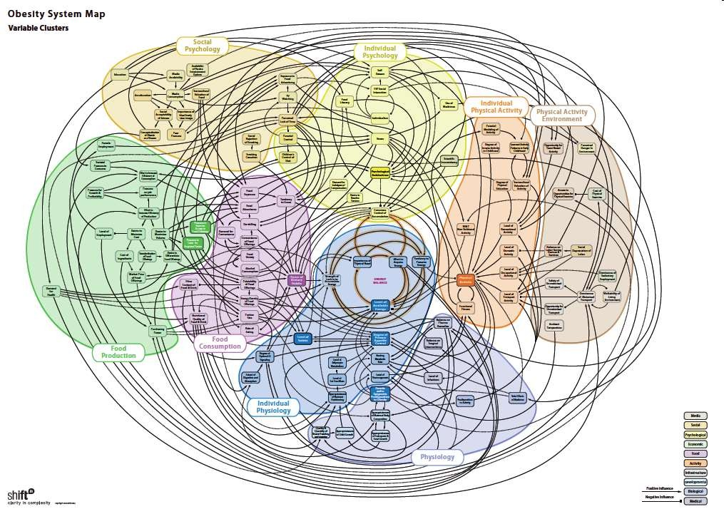
:Source
Bad design may look like this…

Slide 27
Modularity
In technical terms, modules should display:
high cohesion
low coupling.
We next discuss:
cohesion and coupling.

Slide 28
Modularity
Arrangement of modules in a hierarchy ensures:
Low fan-out
Abstraction

Slide 29
Coupling: Degree of dependence among components
High coupling makes modifying parts of the system difficult, e.g., modifying a component affects all the components to which the component is connected.
No dependencies
Loosely coupled-some dependencies
Source: Pfleeger, S., Software Engineering
Theory and Practice. Prentice Hall, 2001.
Highly coupled-many dependencies

Slide 30
Cohesion and Coupling
Cohesion is a measure of:
functional strength of a module.
A cohesive module performs a single task or function.
Coupling between two modules:
A measure of the degree of interdependence or interaction between the two modules.

Slide 31
Cohesion and Coupling
A module having high cohesion and low coupling:
Called functionally independent of other modules:
A functionally independent module needs very little help from other modules and therefore has minimal interaction with other modules.

Slide 32
Advantages of Functional Independence
Better understandability
Complexity of design is reduced,
No dependencies
Different modules easily understood in isolation:
– Modules are independent
Highly coupled-many dependencies

Slide 33
Why Functional Independence is Advantageous?
Functional independence reduces error propagation.
degree of interaction between modules is low.
an error existing in one module does not directly affect other modules.
Also: Reuse of modules is possible.
No dependencies

Slide 34
Reuse: An Advantage of Functional Independence
A functionally independent module:
can be easily taken out and reused in a different program.
each module does some well-defined and precise function
the interfaces of a module with other modules is simple and minimal.

Slide 35
Measuring Functional Independence
Unfortunately, there are no ways:
to quantitatively measure the degree of cohesion and coupling:
At least classification of different kinds of cohesion and coupling:
will give us some idea regarding the degree of cohesiveness of a module.

Slide 36
Classification of Cohesiveness
Classification can have scope for ambiguity:
yet gives us some idea about cohesiveness of a module.
By examining the type of cohesion exhibited by a module:
we can roughly tell whether it displays high cohesion or low cohesion.

Slide 37
functional
sequential
communicational
procedural
temporal
logical
coincidental
Classification of
Cohesiveness
Degree of
cohesion

Slide 38
Coincidental cohesion
The module performs a set of tasks:
which relate to each other very loosely, if at all.
That is, the module contains a random collection of functions.
functions have been put in the module out of pure coincidence without any thought or design.

Slide 39
Coincidental Cohesion - example
Module AAA{
Print-inventory(); Register-Student(); Issue-Book();
};

Slide 40
Logical cohesion
All elements of the module perform similar operations:
e.g. error handling, data input, data output, etc.
An example of logical cohesion:
a set of print functions to generate an output report arranged into a single module.

Slide 41
Logical Cohesion
module print{
void print-grades(student-file){ …}
void print-certificates(student-file){…} void print-salary(teacher-file){…}
}

Slide 42
Temporal cohesion
The module contains functions so that:
all the functions must be executed in the same time span.
Example:
The set of functions responsible for
initialization,
start-up, shut-down of some process, etc.

Slide 43
init() {
Check-memory();
Check-Hard-disk(); Initialize-Ports(); Display-Login-Screen();
}
Temporal Cohesion – Example

Slide 44
Procedural cohesion
The set of functions of the module:
all part of a procedure (algorithm)
certain sequence of steps have to be carried out in a certain order for achieving an objective,
e.g. the algorithm for decoding a message.

Slide 45
Communicational cohesion
All functions of the module:
Reference or update the same data structure,
Example:
The set of functions defined on an array or a stack.

Slide 46
Communicational Cohesion
handle-Student- Data() {
Static Struct Student-data[10000];
Store-student-data(); Search-Student-data(); Print-all-students();
Function A
Function B
Function C
};
Communicational Access same data

Slide 47
Sequential cohesion
Elements of a module form different parts of a sequence,
output from one element of the sequence is input to the next.
Example:
sort
search
display

Slide 48
Functional cohesion
Different elements of a module cooperate:
to achieve a single function,
e.g. managing an employee's pay-roll.
When a module displays functional cohesion,
we can describe the function using a single sentence.

Slide 49
Write down a sentence to describe the function of the
module
– If the sentence is compound,
Determining Cohesiveness
it has a sequential or communicational cohesion.
If it has words like “first”, “next”, “after”, “then”, etc.
it has sequential or temporal cohesion.
If it has words like initialize,
it probably has temporal cohesion.

Slide 50
Coupling
Coupling indicates:
how closely two modules interact or how interdependent they are.
The degree of coupling between two modules depends on their interface complexity.

Slide 51
Coupling
There are no ways to precisely measure coupling between two modules:
– classification of different types of coupling will help us to approximately estimate the degree of coupling between two modules.
Five types of coupling can exist between any two modules.

Slide 52
Classes of coupling
data
stamp
control
common
content
Degree of coupling

Slide 53
Data coupling
Two modules are data coupled,
if they communicate via a parameter:
an elementary data item,
e.g an integer, a float, a character, etc.
The data item should be problem related:
not used for control purpose.

Slide 54
Stamp coupling
Two modules are stamp coupled,
if they communicate via a composite data item
or an array or structure in C.

Slide 55
Control coupling
Data from one module is used to direct
order of instruction execution in another.
Example of control coupling:
a flag set in one module and tested in another module.

Slide 56
Common Coupling
Two modules are common coupled,
– if they share some global data.

Slide 57
Content coupling
Content coupling exists between two modules:
if they share code,
e.g, branching from one module into another module.
The degree of coupling increases
from data coupling to content coupling.

Slide 58
Software Design
Software design model consists of 4 designs:
Data/class Design
Architectural Design
Interface Design
Component Design

Slide 59
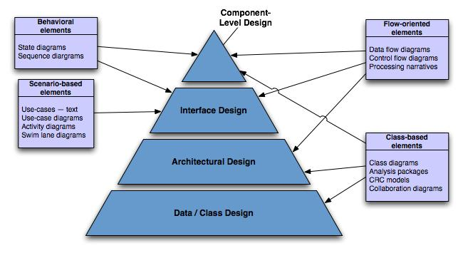
Translating Analysis → Design

Slide 60
Data/class design - Created by transforming the analysis model class-based elements into classes and data structures required to implement the software
Architectural design - defines the relationships among the major structural elements of the software, it is derived from the class-based elements and flow-oriented elements of the analysis model
Interface design - describes how the software elements, hardware elements, and end-users communicate with one another, it is derived from the analysis model scenario-based elements, flow-oriented elements, and behavioral elements
Component-level design - created by transforming the structural elements defined by the software architecture into a procedural description of the software components using information obtained from the analysis model class-based elements, flow-oriented elements, and behavioral elements

Slide 62
Thank You!
For any query/suggestions pls mail us at
suggestions@medicaps.ac.in

